Slide 1
An Individual Participant Data Meta-Analysis of the Machine Learning Models in Predicting Customer Churn
Khanh Tran

Slide 2
Research Motivation & Objectives
Business Context: Companies leverage data-driven strategies to stay competitive
Variability in Model Outcomes: Existing studies show substantial differences in churn prediction results.
Need for Comprehensive Analysis: Utilizing diverse ML techniques and public datasets to evaluate model performance across industries.
Research Goal: Employ an Individual Participant Data Meta-Analysis (IPD-MA) to enhance the understanding of ML model performance across different contexts.
Notes:
Business Context: Since the business environment is highly competitive, companies leverage data-driven strategies to stay competitive, focusing on customer retention alongside acquisition.
Variability in Model Outcomes: Existing studies show substantial differences in churn prediction results due to various factors like dataset characteristics and industry specifics.
Need for Comprehensive Analysis: Utilizing diverse ML techniques and public datasets to evaluate model performance across industries.
Research Goal: Employ an Individual Participant Data Meta-Analysis (IPD-MA) to address inconsistencies and enhance the understanding of model performance across different contexts.

Slide 3
Literature Review
Saradhi et al. (2011) reviewed three machine learning techniques in the employee churn context.
Qureshi et al. (2013) used logistic regression, decision trees, and artificial neural networks to predict potential Customer DNA website dataset churners.
Sisodia et al. (2017) used five machine learning algorithms—linear SVM, decision tree, random forest, k-nearest neighbor, and naive Bayes classifier—to build a model for predicting the churn rate for an HR analytics dataset.
Ahmad et al. (2019) developed a churn prediction model using a dataset from SyriaTel telecom company.
Geiler et al (2022) compared the performance of various ML algorithms on several public datasets

Slide 4
Literature Review
Meta-analysis rooted in the synthesis of the effectiveness of medical and psychological interventions in the 1970s (Glass 2015, Gurevitch et al. 2018)
Meta-analysis is of increasing importance in management research & related fields:
Bergh et al.2016, Combs et al. 2019 applied meta-analysis in general management
Havranek et al. 2020 applied meta-analysis in economics and finance
DeSimone et al. 2020 in organizational studies
Steel et al. 2021 in international business
Notes:
Rooted in the synthesis of the effectiveness of medical and psychological interventions in the 1970s (Glass 2015; Gurevitch et al. 2018), meta-analysis is nowadays also an established method in management research and related fields.
The increasing importance of meta-analysis in management research has resulted in the publication of guidelines in recent years that discuss the merits and best practices in various fields, such as general management (Bergh et al. 2016; Combs et al. 2019; Gonzalez-Mulé and Aguinis 2018), international business (Steel et al. 2021), economics and finance (Geyer-Klingeberg et al. 2020; Havranek et al. 2020), marketing (Eisend 2017; Grewal et al. 2018), and organizational studies (DeSimone et al. 2020; Rudolph et al. 2020).

Slide 5
Literature Review
Existing studies show substantial differences in churn prediction results.
This study aims to generalize and enhance the understanding of ML model performance across different contexts.
Extend the application of the IDP-MA method to a new domain.

Slide 6
Dataset Searching
Individual Dataset - EDA & Processing
Individual Dataset EDA & Processing
Individual Dataset - ML Models Evaluation
Predictive Models Evaluation by Dataset
Aggregated Metrics Mean & Standard Error by ML Models and by Datasets
Aggregated Metrics Mean & Standard Error by ML Models and by Datasets
Estimate Pooled and CI of Effect Size by Using Fixed & Random Effect Methods
Estimate Pooled and CI of Effect Size by Using Fixed & Random Effect Methods
Interpret the results
Interpret the results
Notes:
Web of science

Slide 7
Methodology
Dataset Searching
Interpret the results
Individual Dataset EDA & Processing
Estimate Pooled and CI of Effect Size by Using Fixed & Random Effect Methods
Predictive Models Evaluation by Dataset
Aggregated Metrics Mean & Standard Error by ML Models and by Datasets
Notes:
Web of science

Slide 8
Methodology
Datasets Summary
Dataset Names | Links | Entries | Features | Examples of Features | Common Features | Indexes
Telecom Customer Churn | MavenAnalytics | 7043 | 38 | Customer ID, Age, Gender, Services, Billing, Churn status | Customer demographics, service details, billing info, churn indicator | Customer ID
Internet Service Churn | Kaggle | 72274 | 11 | ID, TV/movie subscriptions, Service metrics, Churn | Service usage metrics, churn indicator | ID
Bank Customer Churn Records | Kaggle | 10000 | 18 | CustomerId, Credit Score, Geography, Balance, Churn status | Customer demographics, product usage, churn indicator | CustomerId
Credit Card Churn | Kaggle | 10127 | 21 | CLIENTNUM, Attrition_Flag, Demographics, Credit details, Transactions | Customer demographics, financial behavior, churn indicator | CLIENTNUM
E-commerce Churn | Kaggle | 5630 | 20 | CustomerID, Churn, Purchase metrics, App engagement | Customer engagement metrics, purchase details, churn indicator | CustomerID
Employee Churn | Kaggle | 1070 | 35 | Age, Department, Education, Job Level, Hourly Rate | employee's demographic background, job details, compensation, education, work experience, job satisfaction, and attrition status | EmployeeNumber
Telco Europa | Kaggle | 190776 | 20 | cetel_number', 'days_life', 'device_tecnology', 'price_plan', 'tot_min_call_out', 'churn' | customer’s usage patterns, service details, device and technology preferences, and churn status.
Telcom Cell2Cell | Kaggle | 71047 | 70 | Customer, Age, Churn, Phone,Model, Roam, Revenue | Customer Identification and Demographics, Subscription and Usage Metrics, Device and Equipment Metrics, Financial Metrics | customer
Membership Subcription | Kaggle | 10362 | 15 | 'membership_number', 'annual_fees', 'member_gender', 'member_annual_income', 'agent_code', 'membership_status' | membership term, financial obligations, member demographics, and associated agents | membership_number
Wireless Telecom South Asia | Kaggle | 2000 | 14 | network_age', 'Aggregate_Total_Rev', 'Aggregate_Data_Rev', 'Aggregate_Data_Vol', 'Aggregate_complaint_count' | Customer Lifetime, Revenue Metrics, Usage Metrics, Customer Preferences, Customer Support and Complaints
Nigeria Telecoms Churn | Kaggle | 1401 | 16 | network_age, Total Data Consumption, Total SMS Spend | Demographic Data, Usage Behavior, Financial Transactions, Service and Support Interactions | Customer ID

Slide 9
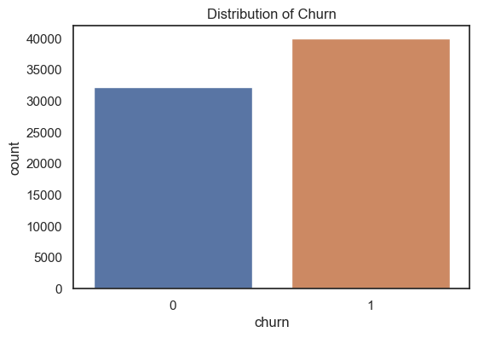
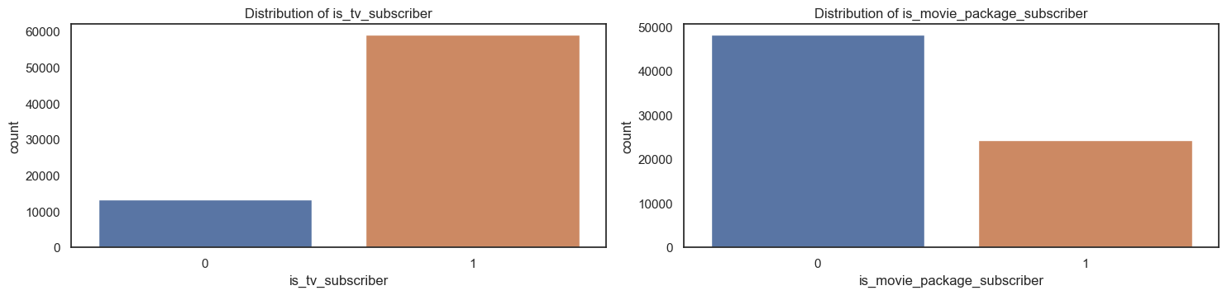
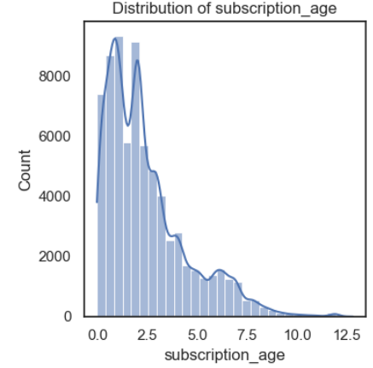
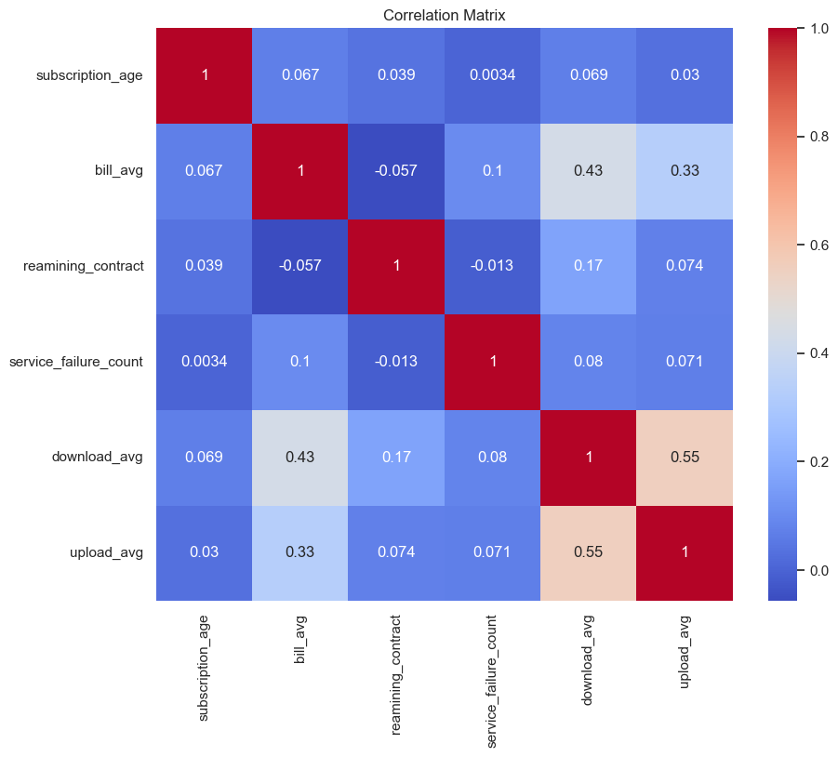
Methodology
Exploratory Data Analysis

Slide 10
Methodology
Data Preparation
The original dataset was stratified split into 75% for train and 25% for test
Some non-informative or directed churn-related features were removed
Categorical missing data were filled by respected most frequent values
Numerical missing data were filled by respected mean values
Standard scaling was applied for numerical features
Categorical variables were applied one-hot encoder

Slide 11
Methodology
ML Models
# Initialize models
models = {
"Logistic Regression": LogisticRegression(random_state=6910),
"SVC": SVC(random_state=6910),
"KNeighbors Classifier": KNeighborsClassifier(),
"GaussianNB": GaussianNB(),
"Decision Tree": DecisionTreeClassifier(random_state=6910),
"Random Forest": RandomForestClassifier(random_state=6910),
"Gradient Boosting": GradientBoostingClassifier(random_state=6910),
"AdaBoost Classifier": AdaBoostClassifier(random_state=6910),
"Bagging Classifier": BaggingClassifier(random_state=6910),
"MLP Classifier": MLPClassifier(random_state=6910),
“XGboost": XGBClassifier(random_state=6910),
“Catboost": CatBoostClassifier(random_state=6910, verbose=False),
“Lightgbm": LGBMClassifier(random_state=6910, verbose=-1)
}

Slide 12
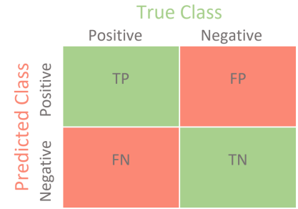
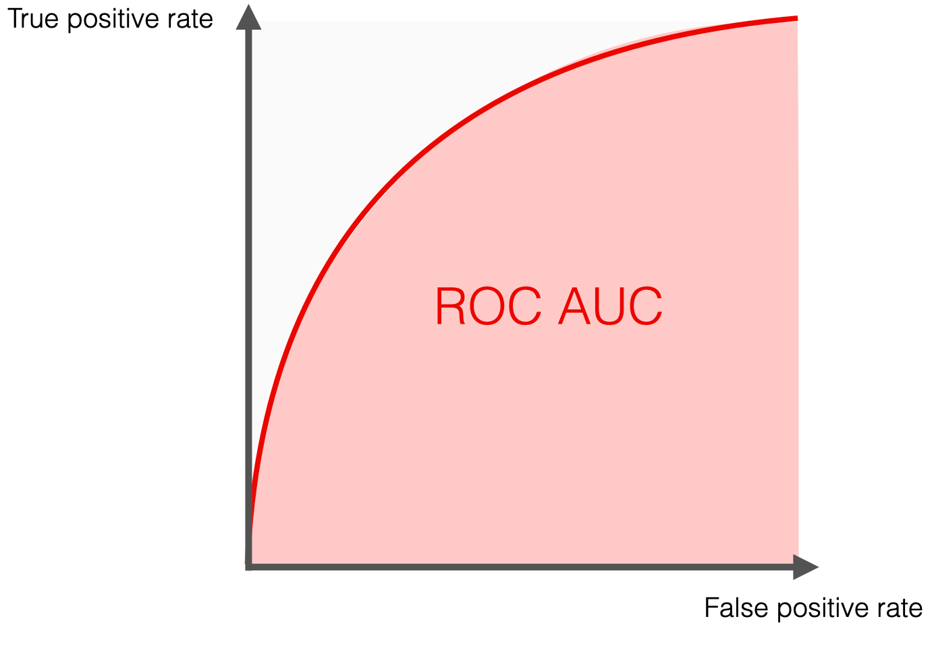
Methodology
Model Evaluation Metrics
Derived metrics from the Confusion Matrix were used for evaluation: accuracy, Precision, Recall, F1 Score, and ROC AUC
Brian, 2020

Slide 13
Methodology
Effect Size And Standard Error For Meta-Analysis
Aggregated mean and standard error of AUCs

Slide 14
Methodology
Fixed-Effect Model
Under the fixed-effect model all studies in the analysis share a common true effect.
The summary effect is our estimate of this common effect size, and the null hypothesis is that this common effect is zero (for a difference) or one (for a ratio).
All observed dispersion reflects sampling error, and study weights are assigned to minimize this within-study error.
Notes:
Under the fixed-effect model all studies in the analysis share a common true effect.
The summary effect is our estimate of this common effect size, and the null hypothesis is that this common effect is zero (for a difference) or one (for a ratio).
All observed dispersion reflects sampling error, and study weights are assigned with the goal of minimizing this within-study error.

Slide 15



Methodology
Fixed-Effect Model Calculation Steps
Step 1: Determine the weights for each study:
Step 2: Calculate the weighted mean effect size:
Step 3: Compute the SE of the weighted mean effect size:
Step 4: Calculate the 95% Confidence Interval:
Notes:
Under the fixed-effect model all studies in the analysis share a common true effect.
The summary effect is our estimate of this common effect size, and the null hypothesis is that this common effect is zero (for a difference) or one (for a ratio).
All observed dispersion reflects sampling error, and study weights are assigned with the goal of minimizing this within-study error.

Slide 16
Methodology
Random-Effect Model
Under the random-effects model, the true effects in the studies are assumed to have been sampled from a distribution of true effects.
The summary effect is our estimate of the mean of all relevant true effects, and the null hypothesis is that the mean of these effects is 0.0 (equivalent to a ratio of 1.0 for ratio measures).
Since our goal is to estimate the mean of the distribution, we need to take account of two sources of variance. Study weights are assigned with the goal of minimizing both sources of variance.
Notes:
Under the random-effects model, the true effects in the studies are assumed to have been sampled from a distribution of true effects.
The summary effect is our estimate of the mean of all relevant true effects, and the null hypothesis is that the mean of these effects is 0.0 (equivalent to a ratio of 1.0 for ratio measures).
Since our goal is to estimate the mean of the distribution, we need to take account of two sources of variance. First, there is within-study error in estimating the effect in each study. Second (even if we knew the true mean for each of our studies), there is variation in the true effects across studies. Study weights are assigned with the goal of minimizing both sources of variance.

Slide 17



Methodology
Random-Effect Model Calculation Steps
Step 1: Calculate Individual Study Variances:
Step 2: Calculate Weights for Fixed-Effect Model:
Step 3: Estimate Between-Study Variance (Tau-squared, τ2):
where:
Notes:
Under the random-effects model, the true effects in the studies are assumed to have been sampled from a distribution of true effects.
The summary effect is our estimate of the mean of all relevant true effects, and the null hypothesis is that the mean of these effects is 0.0 (equivalent to a ratio of 1.0 for ratio measures).
Since our goal is to estimate the mean of the distribution, we need to take account of two sources of variance. First, there is within-study error in estimating the effect in each study. Second (even if we knew the true mean for each of our studies), there is variation in the true effects across studies. Study weights are assigned with the goal of minimizing both sources of variance.

Slide 18


Methodology
Random-Effect Model Calculation Steps
Step 4: Calculate Weights for Random-Effects Model:
Step 5: Calculate the Weighted Mean Effect Size:
Step 6: Compute the Standard Error of the Weighted Mean Effect :
Step 7: Calculate the 95% Confidence Interval:

Slide 19


Methodology
Between Study Heterogeneity
I^2 Statistic
H^2 Statistic
Notes:
The I2 statistic (J. P. Higgins and Thompson 2002) is another way to quantify between-study heterogeneity, and directly based on Cochran’s Q. It is defined as the percentage of variability in the effect sizes that is not caused by sampling error. I2 draws on the assumption that Q follows a χ2 distribution with K−1 degrees of freedom under the null hypothesis of no heterogeneity.
The H2 statistic (J. P. Higgins and Thompson 2002) is also derived from Cochran’s Q, and similar to I2. It describes the ratio of the observed variation, measured by Q, and the expected variance due to sampling error:

Slide 20
Results & Discussions
Effect Size and Standard Errors

Slide 21
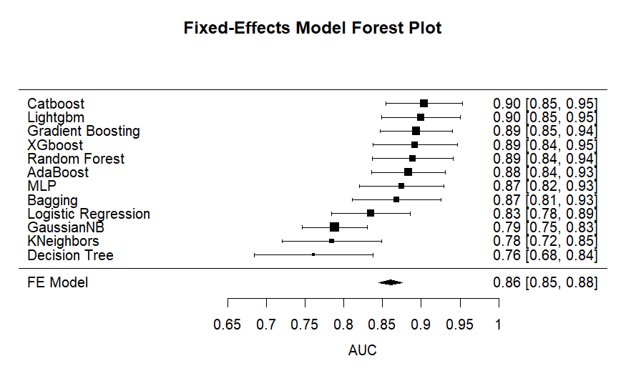
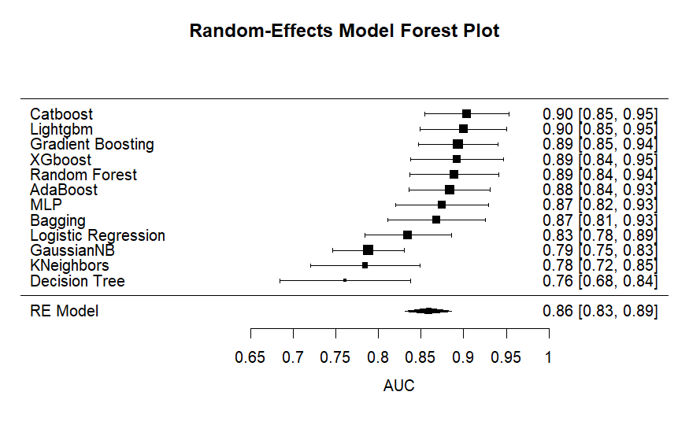
Results & Discussions
FE & RE Model Forests Plot by ML Models

Slide 22
Results & Discussions
Fixed and Random Effects Statistic Tests - ML Models
Omnibus test:
Null hypothesis: model coefficients equal 0
Heterogeneity test:
Null hypothesis: there is no heterogeneity between studies
Fixed and Random Effects
 |  | Q |  | df |  | p
Omnibus test of Model Coefficients |  | 3449.138 |  | 1 |  | < .001
Test of Residual Heterogeneity |  | 35.216 |  | 11 |  | < .001
Note. p -values are approximate.
Note. The model was estimated using Hedges method.
Notes:
The "Omnibus test of Model Coefficients" shows a statistic of 3449.138 with 1 degree of freedom and a very low p-value (less than 0.001), indicating strong evidence against the null hypothesis. It means that model coefficients are not equal to zero. In other words, there is true effect size.
The "Test of Residual Heterogeneity" has a statistic of 35.216 with 11 degrees of freedom and a p-value less than 0.001, suggesting significant variability that is not accounted for by the model. This means that heterogeneity is statistically significant.

Slide 23
Results & Discussions
Residual Heterogeneity Estimate - ML Models
Residual Heterogeneity Estimates
 |  |  |  | 95% Confidence Interval
 |  | Estimate |  | Lower |  | Upper
τ² |  | 0.002 |  | 4.504×10⁻⁴ |  | 0.007
τ |  | 0.043 |  | 0.021 |  | 0.081
I² (%) |  | 71.751 |  | 38.696 |  | 90.112
H² |  | 3.540 |  | 1.631 |  | 10.113
Notes:
𝜏^2: This represents the between-study variance in the data, with an estimated value of 0.002.
𝜏: This is the square root of 𝜏^2, indicating the standard deviation of the true effects across studies, with a value of 0.043.
I^2 (%): This statistic measures the percentage of total variation across studies that is due to heterogeneity rather than chance. Here, it is calculated to be 71.751%, indicating high heterogeneity.
𝐻^2: This is the ratio of the total amount of heterogeneity to the amount expected due to sampling error alone, with a value of 3.54.

Slide 24
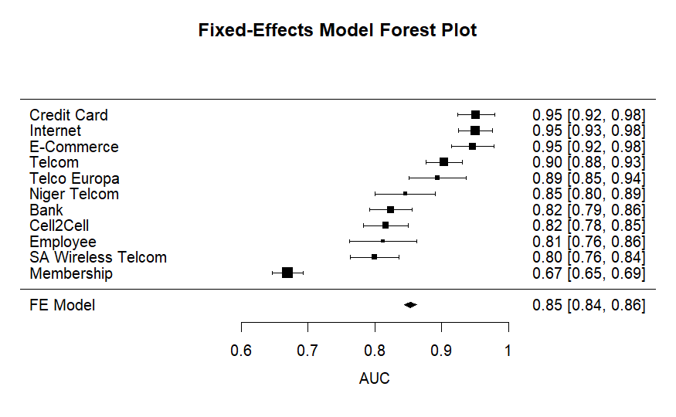
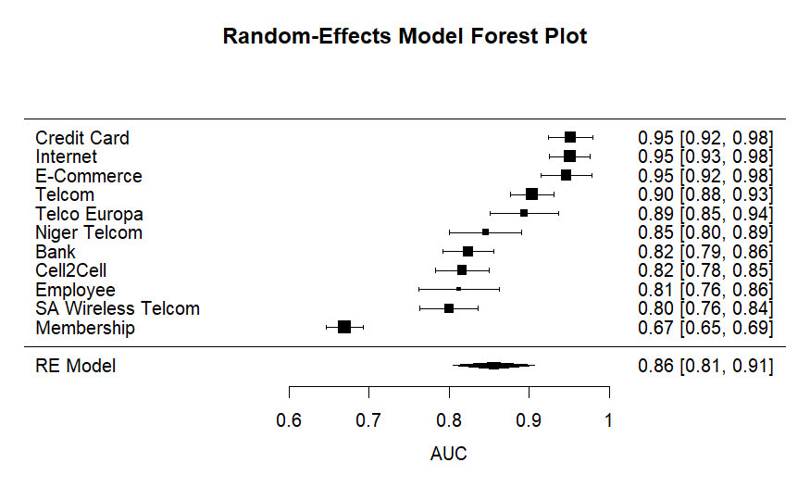
Results & Discussions
FE & RE Model Forests Plot by Datasets

Slide 25
Results & Discussions
Fixed and Random Effects Statistic Tests - Datasets
Omnibus test:
Null hypothesis: model coefficients equal 0
Heterogeneity test:
Null hypothesis: there is no heterogeneity between studies
Fixed and Random Effects
 |  | Q |  | df |  | p
Omnibus test of Model Coefficients |  | 1113.883 |  | 1 |  | < .001
Test of Residual Heterogeneity |  | 408.464 |  | 10 |  | < .001
Note. p -values are approximate.
Note. The model was estimated using Hedges method.
Notes:
The "Omnibus test of Model Coefficients" shows a statistic of 1113.883 with 1 degree of freedom and a very low p-value (less than 0.001), indicating strong evidence against the null hypothesis. It means that model coefficients are not equal to zero. In other words, there is true effect size.
The "Test of Residual Heterogeneity" has a statistic of 408.464 with 10 degrees of freedom and a p-value less than 0.001, suggesting significant variability that is not accounted for by the model. This means that heterogeneity is statistically significant.

Slide 26
Results & Discussions
Residual Heterogeneity Estimate - Datasets
Residual Heterogeneity Estimates
 |  | Estimate
τ² |  | 0.007
τ |  | 0.083
I² (%) |  | 96.328
H² |  | 27.231
Notes:
𝜏^2: This represents the between-study variance in the data, with an estimated value of 0.007.
𝜏: This is the square root of 𝜏^2, indicating the standard deviation of the true effects across studies, with a value of 0.083.
I^2 (%): This statistic measures the percentage of total variation across studies that is due to heterogeneity rather than chance. Here, it is calculated to be 96.328%, indicating high heterogeneity.
𝐻^2: This is the ratio of the total amount of heterogeneity to the amount expected due to sampling error alone, with a value of 27.231.

Slide 27
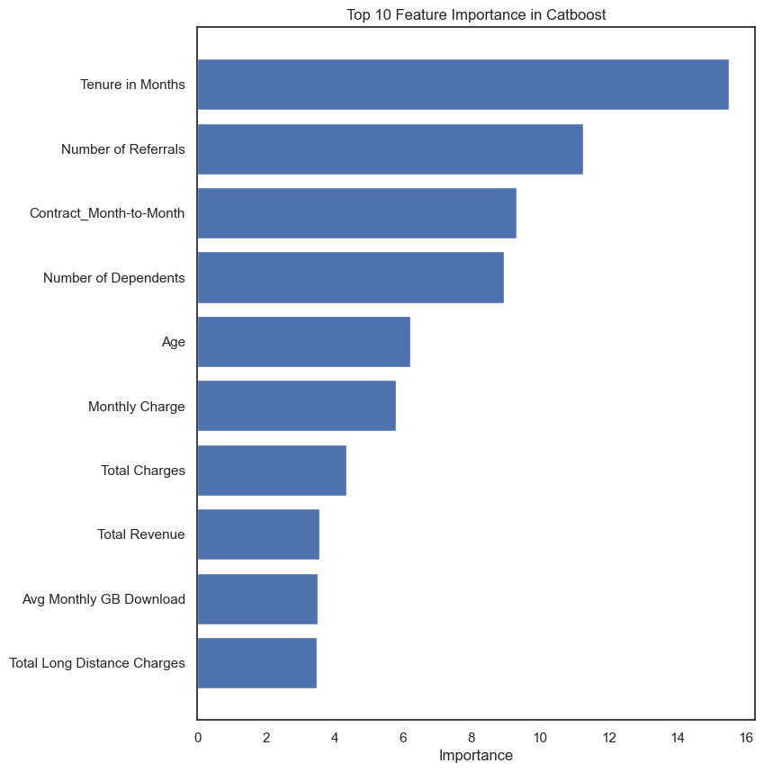
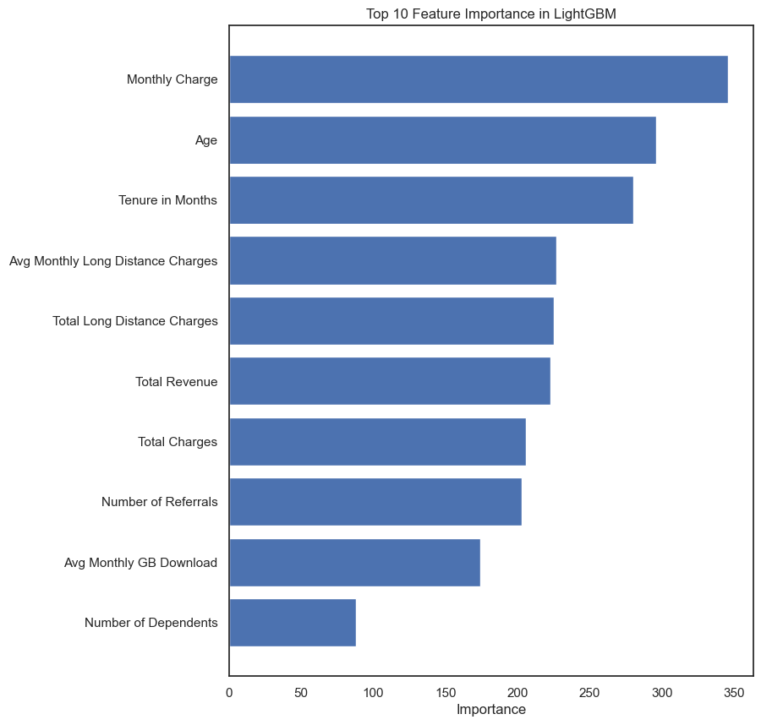
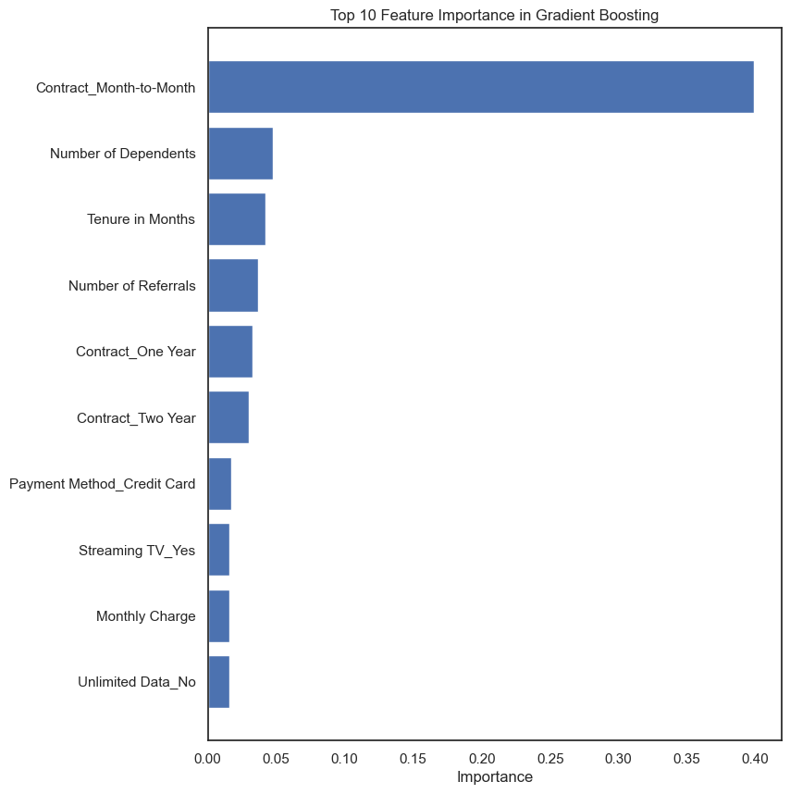
Results & Discussions
Feature Importance - Telcom Churn Dataset

Slide 28
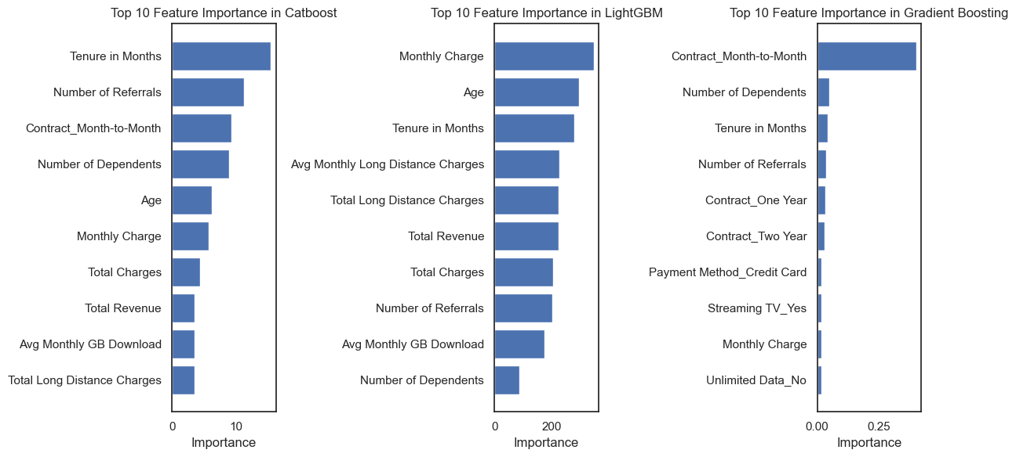

Slide 29
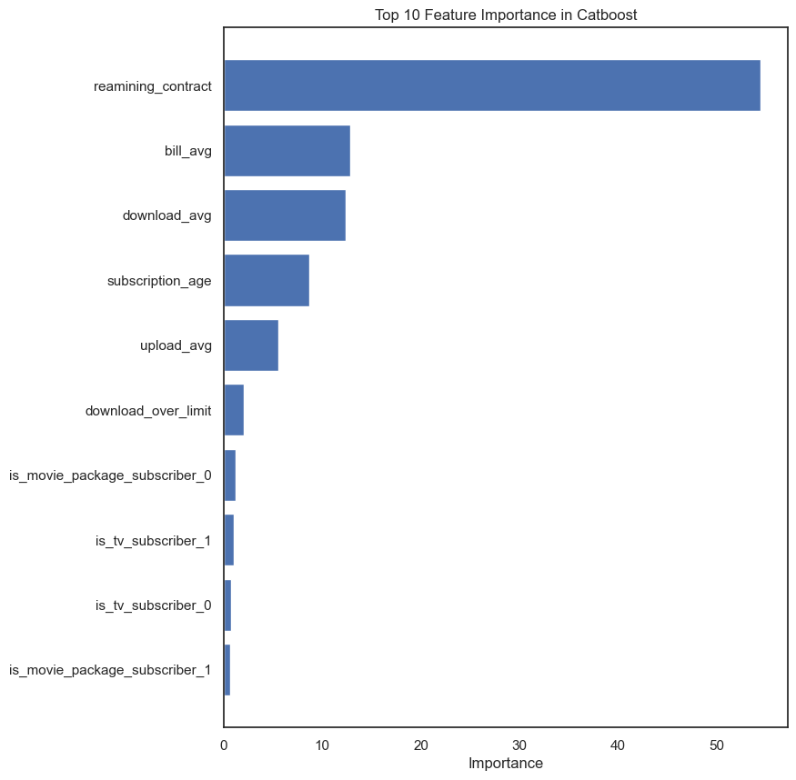
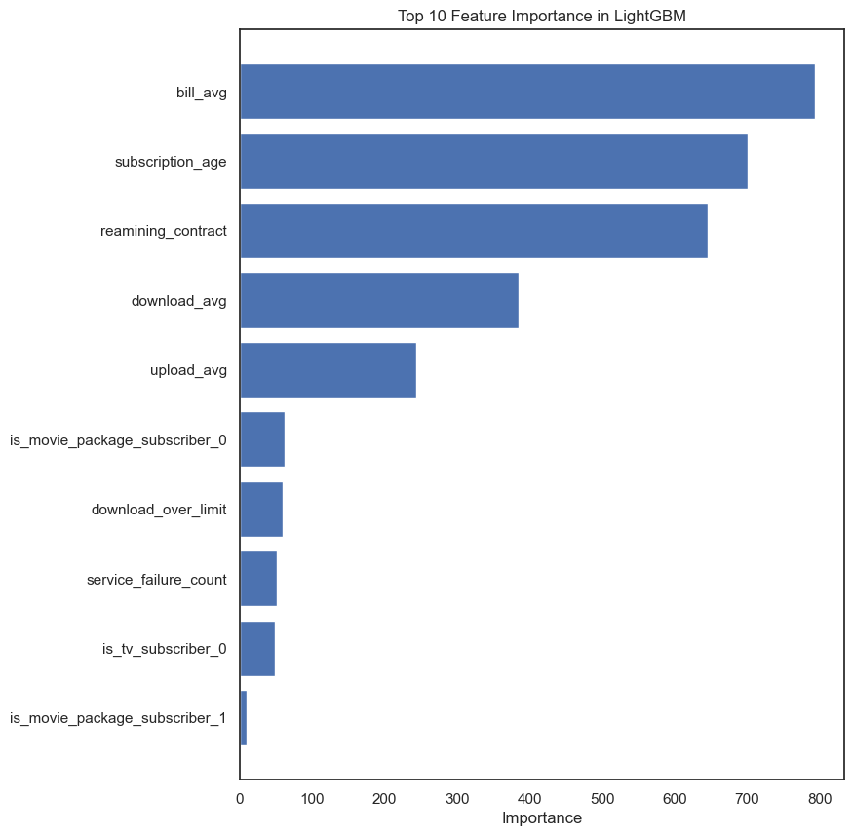
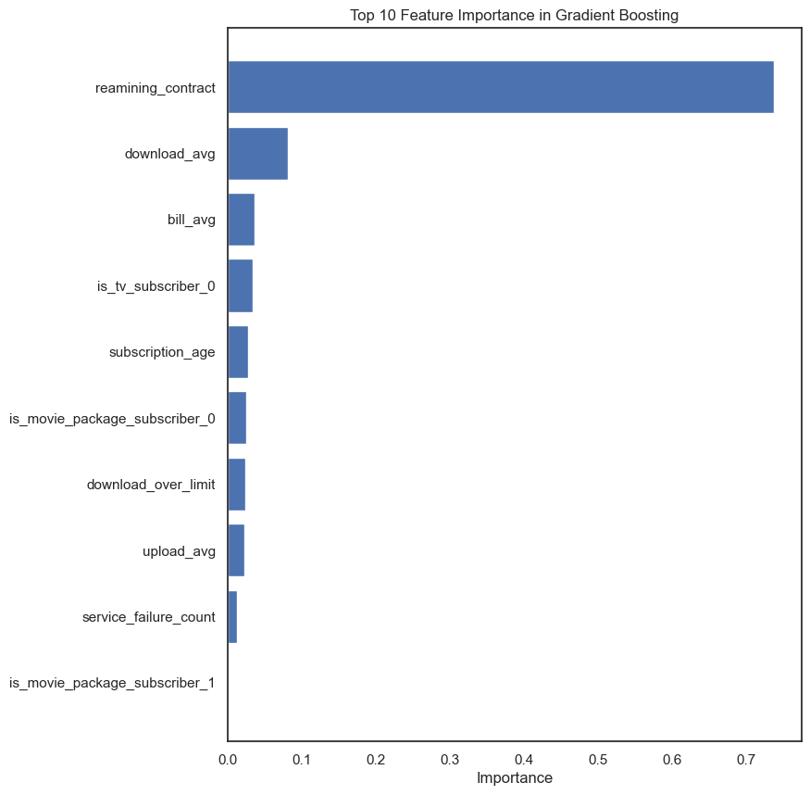
Results & Discussions
Feature Importance - Internet Churn Dataset

Slide 30
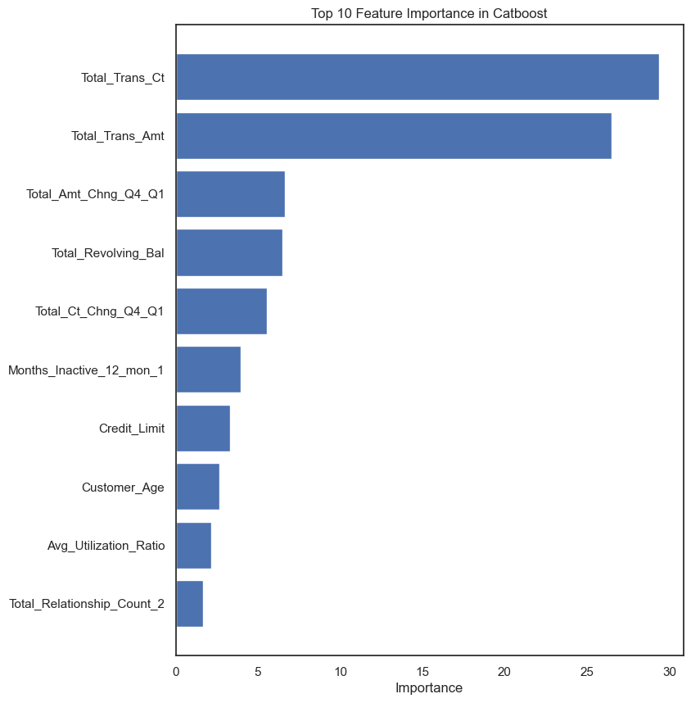
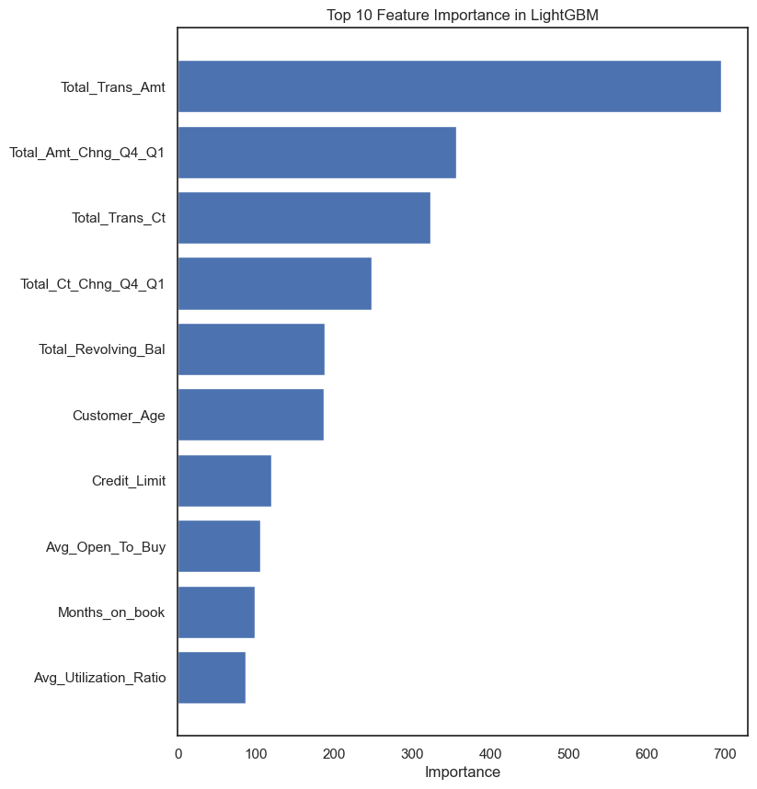
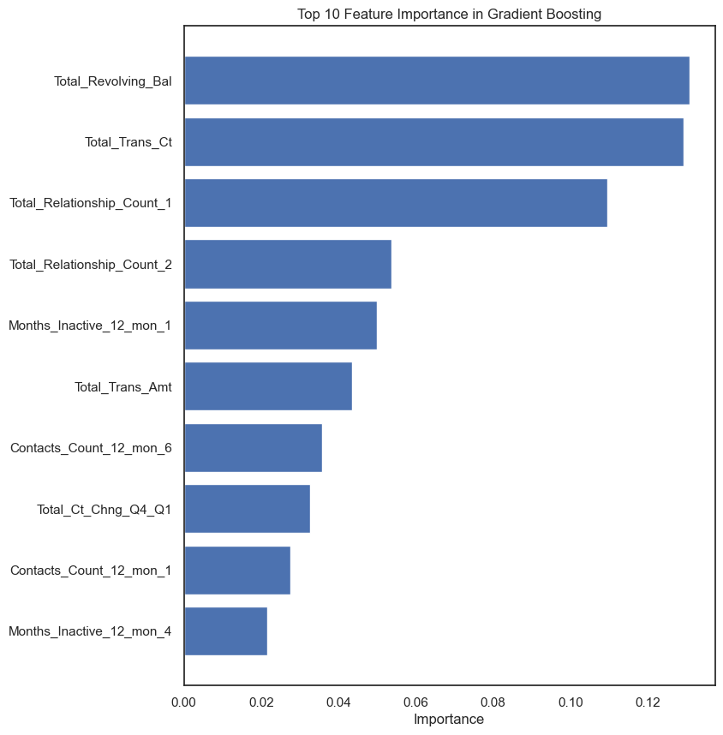
Results & Discussions
Feature Importance - Credit Card Churn Dataset

Slide 31
Conclusions
Evaluated various ML algorithms’ performance on 11 public datasets
ML models can effectively predict customer churn with a pooled mean AUC of 0.86 and 95% CI [0.83-0.89]
Model evaluation results and high heterogeneity show a large variation in the performance of ML algorithms. Boosting algorithms outperform - top 3 performers are Catboost, LightGBM, and Gradient Boosting with mean AUC of 0.9, 0.9, 0.89, and 95% CI [0.85-0.95], [0.85-0.95], [0.85-0.94], respectively.
Large variation of the ML model’s performance across datasets
Feature importance shows that in general variables related to product usage and service detail are the top feature importance

